Slide 1
Office 365 Development

Slide 2



Recap
Introduction to Office 365 development
Module 1: Introduction to Office 365 development
Module 2: Getting started with Apps for Office
Module 3: Getting started with Apps for SharePoint
Module 4: Moving Full Trust Code to the Cloud Using Repeatable Patterns and Best Practices
Module 5: Getting started with the Office 365 APIs
dev.office.com/training

Slide 3
Course Agenda
Deep Dive into Integrating Office 365 APIs with Web Applications
Module 1: Deep Dive into Azure AD with the Office 365 APIs
Module 2: Deep Dive into Office 365 APIs for Calendar, Mail, and Contacts
Module 3: Deep Dive into Office 365 APIs for OneDrive for Business
Module 4: Deep Dive into Office 365 APIs for SharePoint Site services
Module 5: Deep Dive into Office 365 APIs for Yammer services
Module 6: Deep Dive into Office 365 APIs for Office Graph
Module 7: Deep Dive into Office 365 APIs for OneNote services

Slide 4
Deep Dive into Office 365 APIs for SharePoint Site services

Slide 5

Agenda
Overview
File Operations with SharePointClient
List Operations with REST

Slide 6
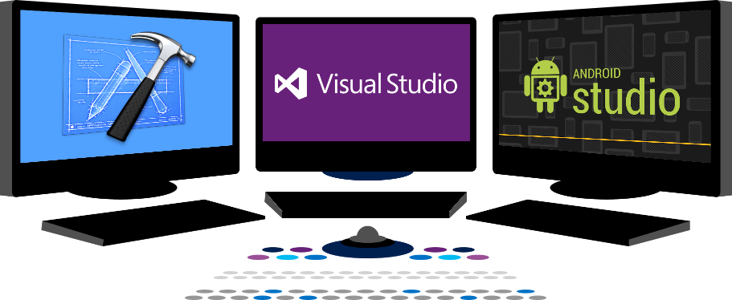














Vision
EXTEND OFFICE EVERYWHERE
CONNECT TO OFFICE 365 SERVICES
BUILD USING AN OPEN PLATFORM
Delve
z
Users and groups
Files
Mail
Calendar
My Apps
Video Portal
Contacts
Office Graph
Presentations
Documents
Spreadsheets
Lync
OneNote
Yammer

Slide 7
Overview

Slide 8
SharePoint Sites Services
Provides access to SharePoint online REST API
SharePointClient class simplifies programming, but limited functionality
Direct REST API calls more complex, but exposes more functionality
Notes:
The purpose of this module is to show how you can access the complete SharePoint REST API
The SharePointClient only has access to Files, but we can get an Access Token via the Discovery Service for use with REST calls.

Slide 9
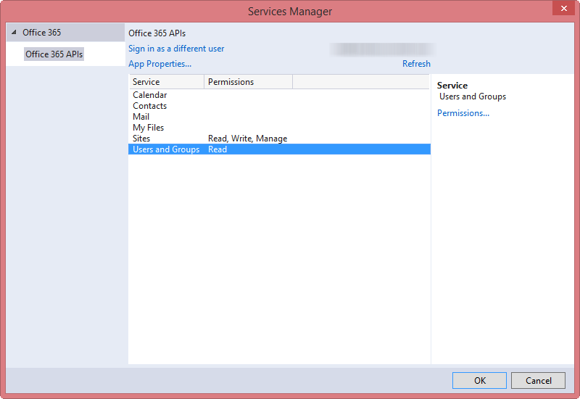
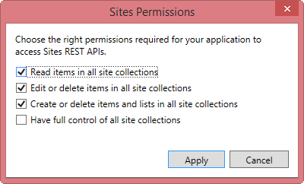
Permissions
Notes:
Just to show the various permissions that are available

Slide 10
File Operations with SharePointClient

Slide 11
SharePointClient class
Get an Access Token for the specific resource
Create SharePointClient instance
SharePointClient.Files abstracts Files API
Notes:
The discovery service discovers the SharePoint resource, which we can use to access document libraries

Slide 12
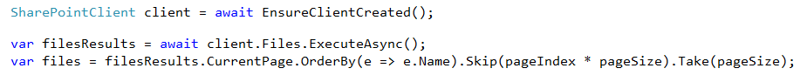
Reading File Metadata
Read Files collection
Can also read an individual Folder
Paging is accomplished post-query using LINQ
Notes:
No support for $skip and $orderby so paging is post-query

Slide 13
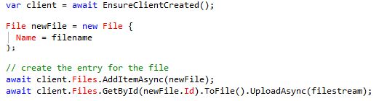
Uploading a new File
Use AddItemAsync method
Provide a file name and the file stream

Slide 14
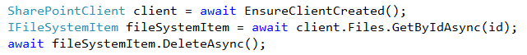
Deleting a File
Get the target file using GetByAsync method
Delete using DeleteAsync method

Slide 15
demo
File operations with the SharePointClient

Slide 16
List Operations with REST

Slide 17
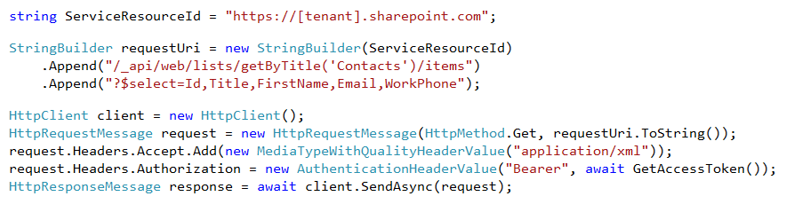
Reading List Items
Access the SharePoint REST API with the Access Token
Notes:
No support for $skip and $orderby so paging is post-query

Slide 18
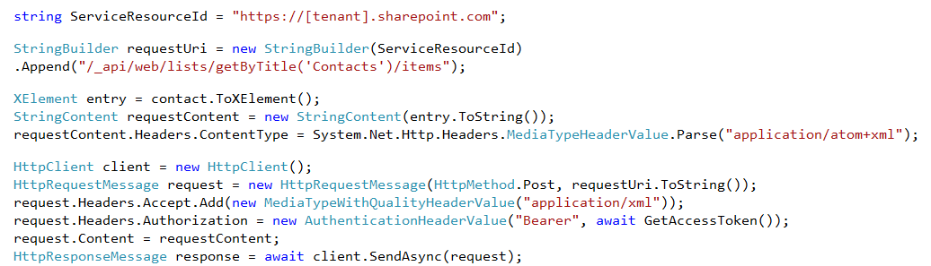
Adding a New List Item
Create message with list item data
POST to list items endpoint

Slide 19
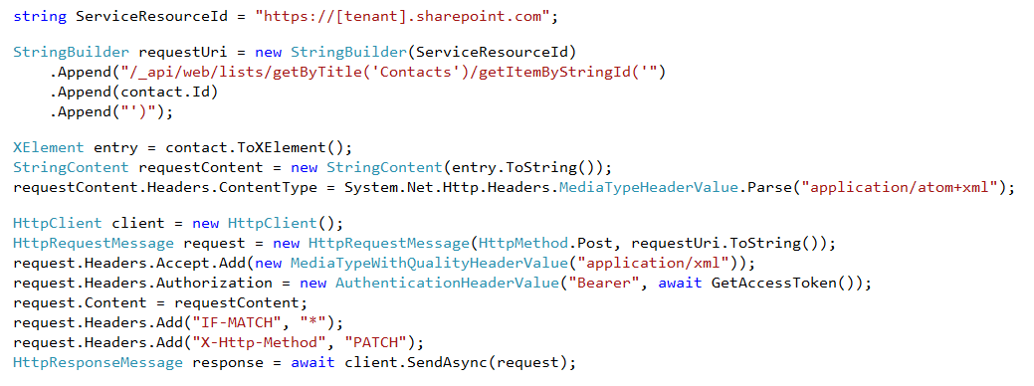
Updating a List Item
Create message with list item data
POST to target item ID
Notes:
Notice how the FormDigest isn’t passed
We get all the permissions we need from Azure Active Directory

Slide 20
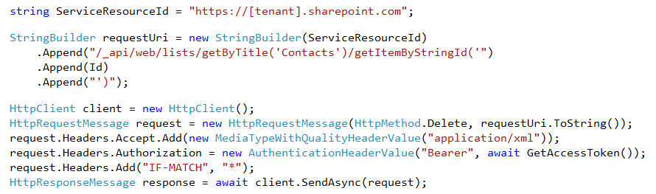
Deleting a List Item
DELETE the target item by ID
Supports the use of eTags

Slide 21
demo
List Operations with REST

Slide 22
Summary
Overview
File Operations with SharePointClient
List Operations with REST

Slide 23


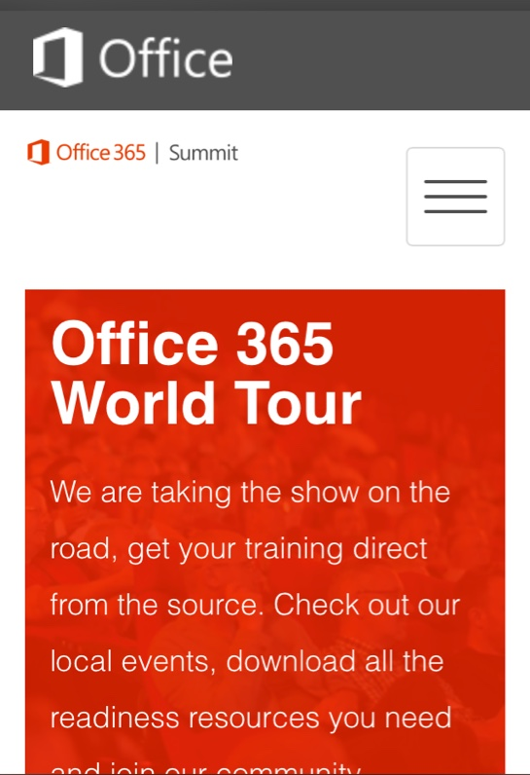
dev.office.com
Sign up
http://dev.office.com/getting-started
Explore
http://apisandbox.msdn.microsoft.com
Get trained http://dev.office.com/training

Slide 24


Feedback
Office 365 Network Share you best practices and join conversations https://www.yammer.com/itpronetwork
Stackoverflow Ask deep technical questions to a world-wide set of developers
http://stackoverflow.com/questions/tagged/ms-office
UserVoice Provide suggestions of what you want in future versions
http://officespdev.uservoice.com/

Slide 25

© 2014 Microsoft Corporation. All rights reserved. Microsoft, Windows, and other product names are or may be registered trademarks and/or trademarks in the U.S. and/or other countries.
The information herein is for informational purposes only and represents the current view of Microsoft Corporation as of the date of this presentation. Because Microsoft must respond to changing market conditions, it should not be interpreted to be a commitment on the part of Microsoft, and Microsoft cannot guarantee the accuracy of any information provided after the date of this presentation. MICROSOFT MAKES NO WARRANTIES, EXPRESS, IMPLIED OR STATUTORY, AS TO THE INFORMATION IN THIS PRESENTATION.

